Slide 1
Tutorial 4
Jun ZHAO
Assistant Professor
School of Computer Science and Engineering
Nanyang Technological University
WhatsApp: http://personal.ntu.edu.sg/JunZhao/whatsapp.png
WeChat: https://personal.ntu.edu.sg/JunZhao/wechat.png
Singapore Phone Number (WhatsApp): 8648 3534
Email or Microsoft Teams: JunZhao@ntu.edu.sg
Notes:
Hello, everyone. Thank you for coming. This is Tutorial One for Net-Centric Computing. I am Jun Zhao, a faculty member at NTU.

Slide 2
What is the principal difference between connectionless communication and connection-oriented communication?
Notes:
In this question, we are asked the principal difference between connectionless communication and connection-oriented communication.

Slide 3


Question 1’s Answer:
Connection-oriented communication has three phases. In the establishment phase a request is made to set up a connection. Only after this phase has been successfully completed can the data transfer phase be started and data transported. Then comes the release phase.
Connectionless communication does not have these phases. It just sends the data.
Notes:
Connection-oriented service is modeled after the telephone system. In the establishment phase a request is made to set up a connection, which is like a tube. After this phase /feɪz/ is successfully done, we have the data transfer phase. Finally, after data transmission is completed, the connection will be deleted.
Connectionless service is modeled after the postal system. Just like you may get unexpected mails, Connectionless communication does not have the different stage of set up, data transfer, and ending connection. The data is just sent without these phases.
======
The essence of a connection is that it acts like a tube: the sender pushes objects in at one end, and the receiver takes them out in the same order at the other end. Connection-oriented services are suitable for communicating for a long time between two parties.

Slide 4
Packet switched networks route each packet as a separate unit, independent of all others. Virtual-circuit networks do not have to do this, since each data packet follows a predetermined route. Does this observation mean that virtual-circuit networks do not need the capability to route isolated packets from an arbitrary source to an arbitrary destination? Explain your answer.
Knowledge point:
Packet switched: connectionless (just like postmail)
Virtual circuit: connection-oriented (just like phone communication)
Question 2’s Answer: Virtual circuit subnets most certainly need this capability in order to route connection setup packets from an arbitrary source to an arbitrary destination.
Notes:
The idea behind virtual circuits is to avoid having to choose a new route for every packet sent,
as inFig. 5-2.
Asynchronous transfer mode (ATM)

Slide 5
Question 3:
Consider a packet switched network. Two nodes, node S and node D, are connected through an intermediate node I. A message of size 1000 bytes is transmitted from node S to node D. The message is fragmented into four packets each with a 50-byte header. All links run the same data rate. If propagation delay is negligible, determine the minimum data rate of the links to achieve 100ms of total transmission delay. (Hint: pipeline effect)

Slide 6
Question 3’s Answer:
S
I
D
Transmission time, T_{f}
(frame size = 250 + 50 bytes)
1
Let:
d: the link data rate (to determine)
T_{f}: transmission time of a packet
T: The total transmission time
2
1
3
2
The last bit is sent at time 4T_{f}. To get to the destination, the last packet must be retransmitted by the intermediate router I. The retransmission takes time T_{f}. Then the total delay is T = 5T_{f}
According the question, we know that T<100ms
so, 5T_{f} < 100ms - - - (1)
Since T_{f} = (250 bytes + 50 bytes) * 8 / d - - - (2)
By (1) & (2), d > 120 kbps
4
3
4

Slide 7
A factor in the delay of a store-and-forward packet-switching system is how long it takes to store and forward a packet through a switch. If switching time is 10 µsec, is this likely to be a major factor in the response of a client-server system where the client is in New York and the server is in California? Assume the propagation speed in copper and fiber to be 2/3 the speed of light in vacuum.
Notes:
A factor in the delay of a store-and-forward packet-switching system is how much time it takes to store and forward a packet through a switch. If switching time is 10 micro seconds, is this likely to be a major factor in the response time of a client-server system in which the client is located in New York and the server is in California? The propagation speed in copper and fiber is assumed to be 2/3 the speed of light in vacuum [ˈvæ.kjuːm].
===
=======
The size of TTL field in IP header is 8 bits which means maximum value can be 2^8 = 256. However, because TTL value starts from 0 and not from 1, maximum value for TTL is 255. Every time packet reaches next layer 3 hop (mostly next router), TTL is decremented by 1.

Slide 8
Question 4’s Answer:
The speed of propagation is 200,000 km/sec, i.e., 200 meters/µsec. In 10 µsec the signal travels 2 km.
Thus, each switch adds the equivalent of 2 km of extra cable.
So the questions are: Where is New York and California? How many switches the signal have to travel?
If the client and server are separated by 4000 km (e.g., from New York to San Francisco), traversing even 50 switches adds only 100 km to the total path, which is only 2.5%. Thus, switching delay is not a major factor under this circumstance.
Notes:
The question mentions the propagation speed is two thirds of the speed of light in vacuum [ˈvæ.kjuːm]. So we have The speed of propagation as two thirds times 300 thousands km/sec = 200 thousands km/sec. In 10 microsecond, i.e., 10 \times 10 to the power of minus 6 seconds, the signal travels 200 thousands km/sec * 10 \times 10 to the power of minus 6 sec = 2km. This means that each switch adds the equivalent of 2 km of extra cable. So the main question is how far it is from New York to California? The distance between New York to San Franciscois in California is about 4 thousands km, while traversing 50 switches introduces 100 km to the total path, which is only 2.5%. So, in this case, switching delay is not a major factor.
The maximum number of hops is 64 in iOS , and 255 in WINDOWS.

Slide 9
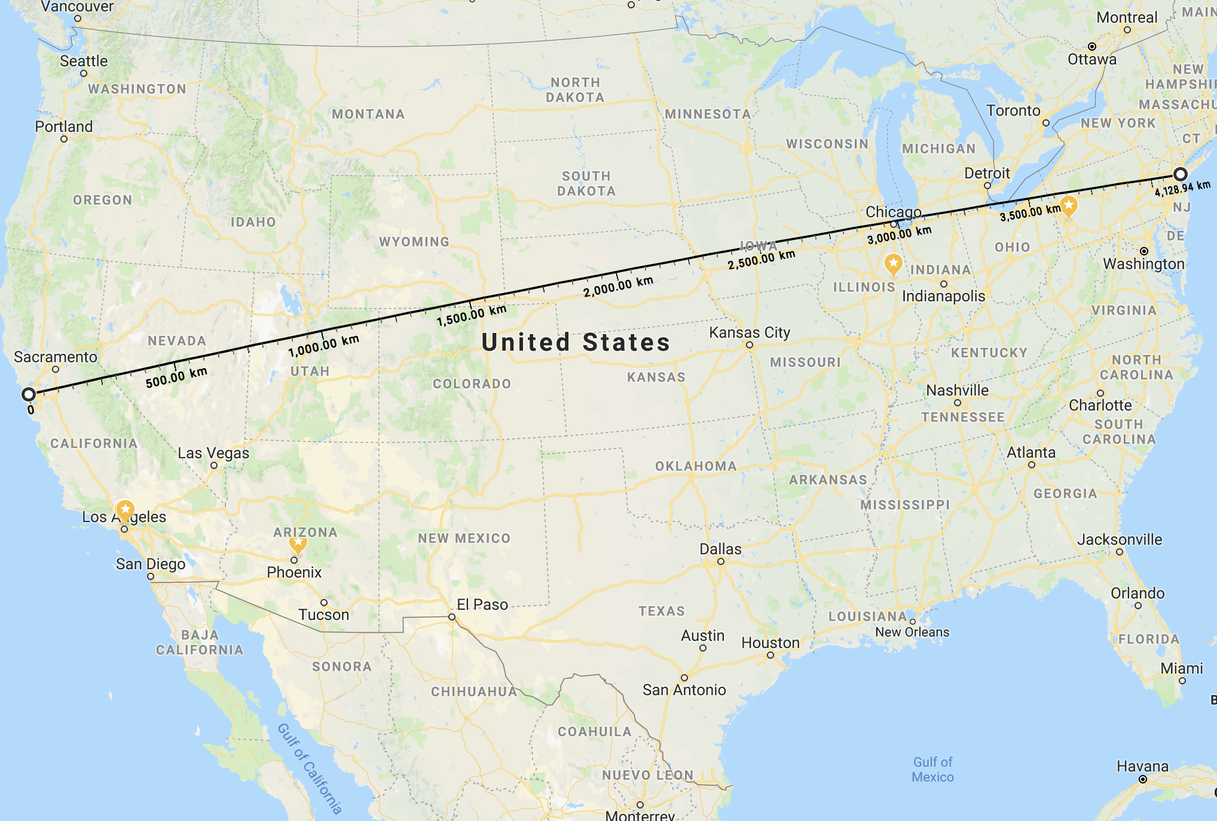
≈ 4000 km
New York
San Francisco

Slide 10
Why assuming 50 switches for the signal to travel from New York to San Francisco?
Maximal number of hops allowed: 64 in MacBook’s Operating System (MacOS), 255 in Windows Operating System.
Even we assume 100 switches, switching delay is just 5% (i.e., not a major factor) of the path delay.

Slide 11
Compare the delay in sending an x-bit message over a k-hop path in a circuit-switched network and in a (lightly loaded) packet-switched network. The circuit set up time is s sec, the propagation delay is d sec per hop, the packet size is p bits, and the data rate is b bps. Under what conditions does the packet network have a lower delay?
Notes:
In this question, we will compare the delay of sending an x-bit message over a k-hop path in a circuit-switched network and in a packet-switched network.
The network parameters are as follows. The circuit set up time equals s sec, the propagation delay is d sec per hop, the packet size is p bits, and the data rate is b bps. Under what conditions, the packet network will have a smaller delay?

Slide 12
Question 5’s Answer —— Slide 1:
With circuit switching,
After s time, the circuit is set up.
After kd more time, the first bit is received by destination.
After x/b more time, the last bit is received by destination.
Total delay: s + x/b + kd
……
source
1
2
k-1
destination
bit x | … | bit 2 | bit 1
bit x | … | bit 2 | bit 1
……
source
1
2
k-1
destination
……
source
1
2
k-1
destination
bit x | … | bit 2 | bit 1
Notes:
We first consider circuit switching.
After s time, the circuit is set up.
When the circuit is set up, after kd more time, the first bit is received by destination.
Starting from the instant that the first bit is received by destination, after x/b more time, the last bit is received by destination.
Summing up these three quantities, we compute the Total delay as s + x/b + kd.

Slide 13
Question 5’s Answer —— Slide 2:
With packet switching,
After p/b+d time, the 1st packet is sent to the 1st hop.
After p/b+d more time, the 1st packet is sent to the 2nd hop.
……
Starting from the instant that the 1st packet is sent to the (k-1)th hop, after p/b+d more time, the 1st packet is sent to the kth hop (i.e., the destination).
Starting from the instant that the 1st packet is sent to the destination, after (x-p)/b more time, the last packet is received by the destination.
Total delay: k * (p/b+d) + (x-p)/b = x/b + (k − 1)p/b + kd.
…… | packet 2 | packet 1
……
source
1
2
k-1
destination
…… | packet 2 | packet 1
……
source
1
2
k-1
destination
…… | packet 2 | packet 1
……
source
1
2
k-1
destination
…… | packet 2 | packet 1
……
source
1
2
k-1
destination
Notes:
We now consider packet switching. After p/b+d time, the 1st packet is sent to the 1st hop. Why? Two reasons. First, the propagation delay is d sec per hop, so it takes time d for the first bit to be received by hop 1. Second, because each packet has p bits and the data transfer speed is b bps, from the time the first bit is received by hop 1, it takes p/b more time for bit p to be received by hop 1.
Similarly, After p/b+d more time, the 1st packet is sent to the 2nd hop. First, the propagation delay is d sec per hop, so it takes time d for the first bit to travel from hop 1 to hop 2. Second, because each packet has p bits, from the time the first bit is received by hop 2, it takes p/b more time for bit p to be received by hop 2.
We can have a similar analysis for each hop. For example, beginning from the instant that the 1st packet is sent to the (k-1)th hop, after p/b+d more time, the 1st packet is sent to the kth hop (i.e., the destination). Why? Two reasons. First, the propagation delay is d sec per hop, so it takes time d for the first bit to travel from hop k-1 to the destination. Second, because each packet has p bits, from the time the first bit is received by the destination, it takes p/b more time for bit p to be received by the destination.
Now assume the destination gets the 1st packet, it takes (x-p)/b more time for the destination to get the last packet, because there are x-p bits and the data transfer speed is b bps.
Summing up these quantities, we compute the Total delay as x/b + (k − 1)p/b + kd.

Slide 14
Question 5’s Answer —— Slide 3:
With circuit switching, the total delay is s + x/b + kd.
With packet switching, the total delay is x/b + (k − 1)p/b + kd.
The total delay with packet switching is smaller if x/b + (k − 1)p/b + kd < s + x/b + kd; i.e., (k − 1)p/b < s.
Notes:
We have obtained these two results. Then The total delay with packet switching is smaller if we have x/b + (k − 1)p/b + kd < s + x/b + kd; which means (k − 1)p/b < s.

Slide 15
In addition to the office hours listed in the previous slide, please feel free to contact Assistant Professor Jun ZHAO as follows to schedule appointments to ask questions. Thanks!
WhatsApp: http://personal.ntu.edu.sg/JunZhao/whatsapp.png
WeChat: https://personal.ntu.edu.sg/JunZhao/wechat.png
Singapore Phone Number (WhatsApp): 8648 3534
Email or Microsoft Teams: JunZhao@ntu.edu.sg
Skype ID: live:junzhaocmu
Office: Block N4, Room 02C-111, 50 Nanyang Ave, Singapore 639798
Homepage: http://personal.ntu.edu.sg/JunZhao/

